Slide 1
CSE 445 Lecture 7
Linear classifier by decision boundaries

Slide 2
Linear Classifier
Linear decision boundary for binary classification
A loss function for classification
The perceptron algorithm

Slide 3
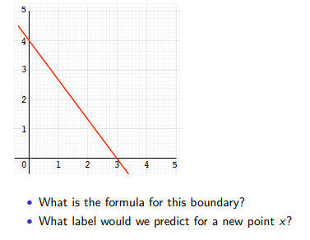
Linear decision boundary for classification

Slide 4
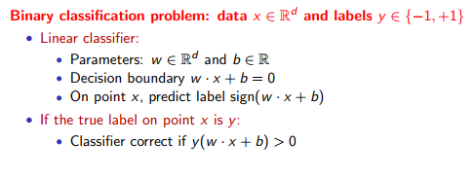
Linear classifiers

Slide 5
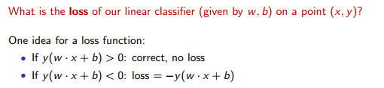
A loss function for classification

Slide 6

A simple learning algorithm

Slide 7
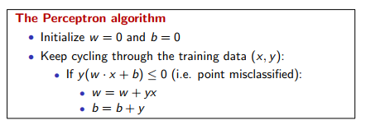
A simple learning algorithm

Slide 8
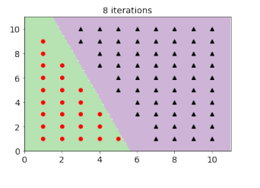
Perceptron algorithm example
85 data points – linearly separable

Slide 9
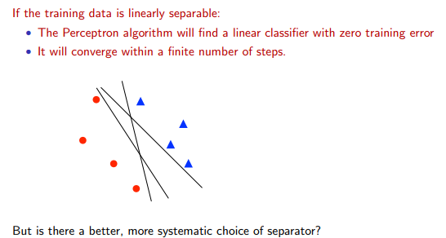
Perceptron convergence

Slide 10
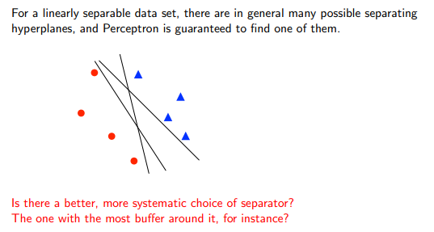
Improving the perceptron

Slide 11
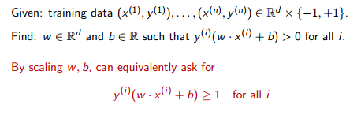
The learning problem

Slide 12
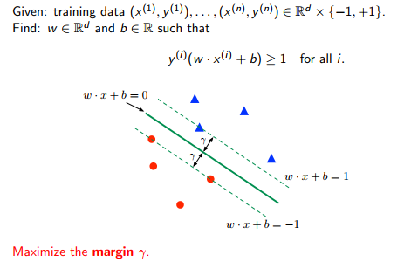
Maximizing the margin

Slide 13
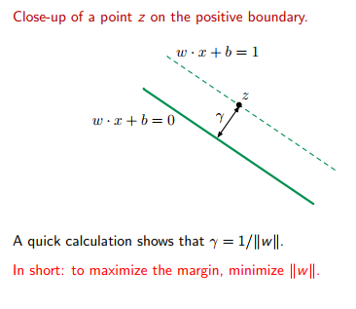
Formula for a margin

Slide 14
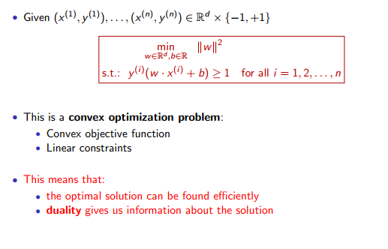
Maximum margin linear classifier

Slide 15
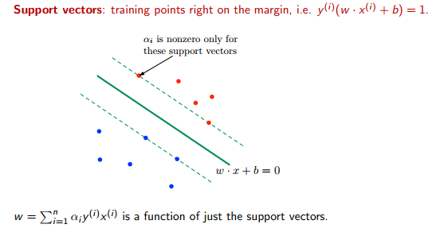
Support vectors

Slide 16
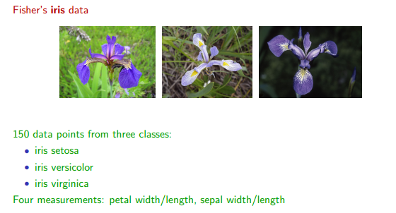
SVM example: Iris data set

Slide 17
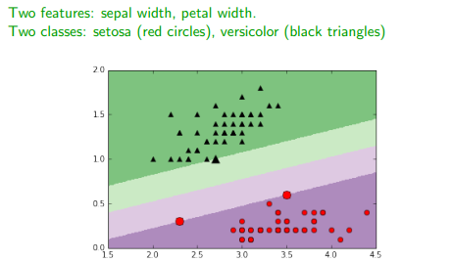
SVM example: Iris data set

Slide 18
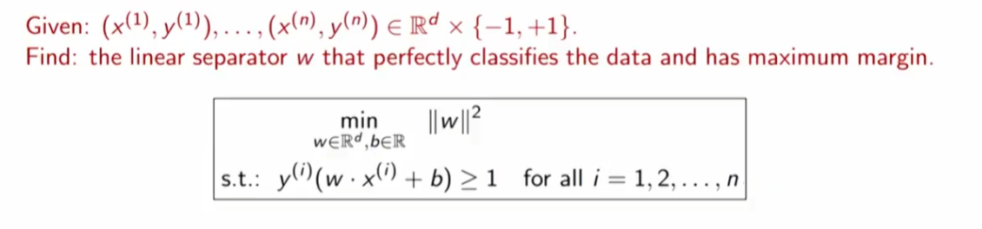
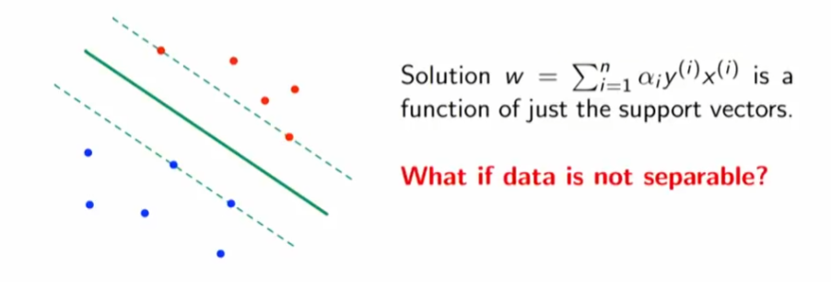
Maximum margin classifier

Slide 19
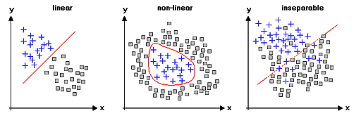
Soft margin SVM
Data that isn’t linearly separable
The idea is to add slack variables for each data point
We need to reformulate the optimization problem
We also set the slack parameters

Slide 20
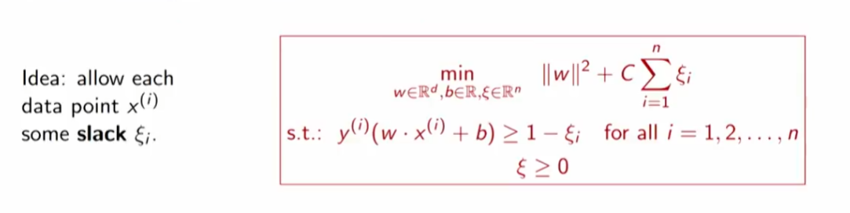
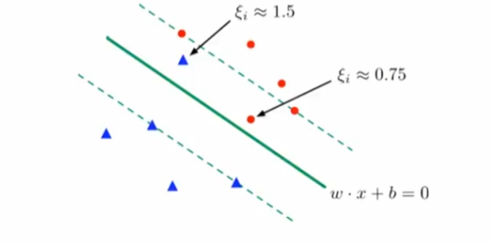
Soft margin classifier

Slide 21
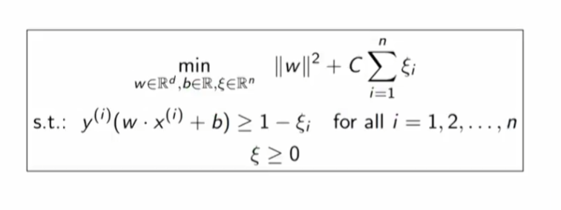
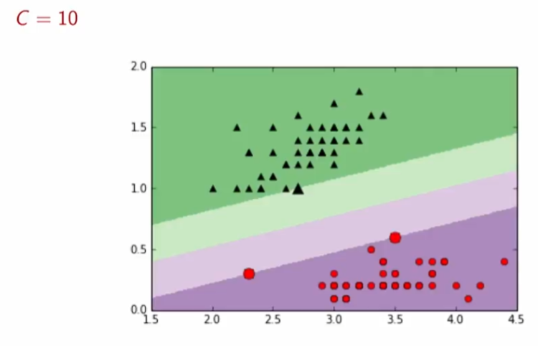
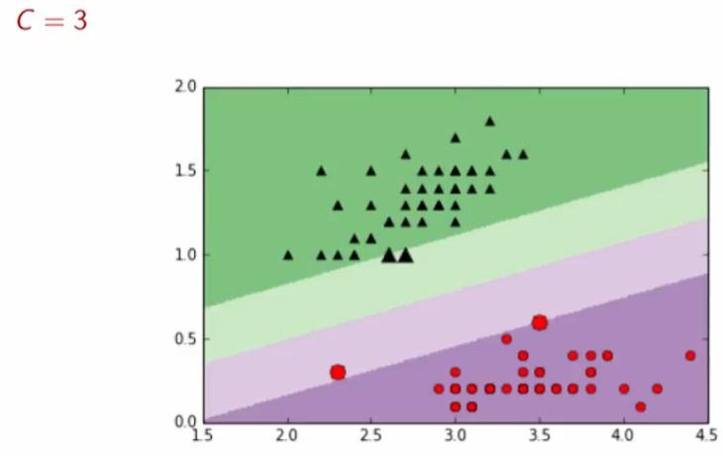
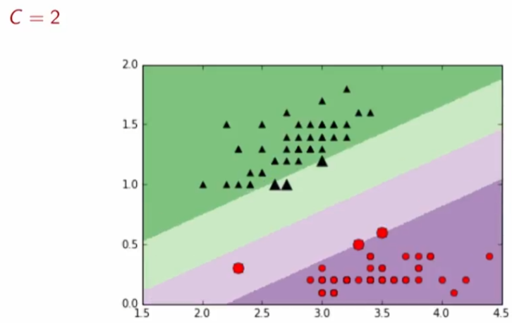
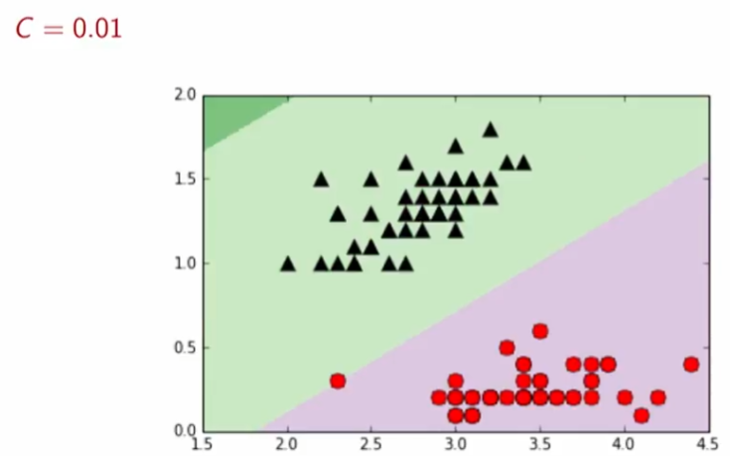
Margin vs Slack

Slide 22
Non-linear boundary
We can use these linear models to do even more than separating
Linearly separable classes and
Inseparable classes
We can find separating boundaries that at
Quadratic or even
More degrees
We need to understand the concept of duality for doing this efficiently

Slide 23
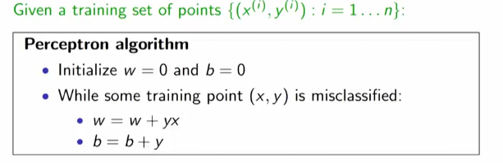
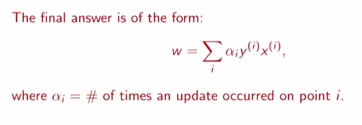

Duality

Slide 24
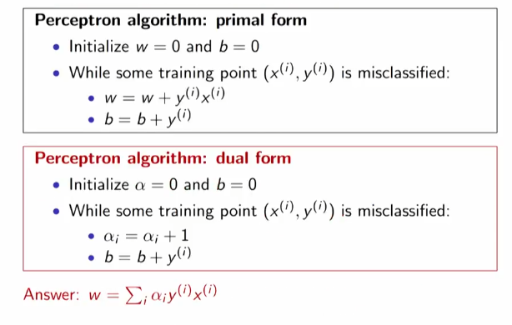
Dual form of the perceptron algorithm

Slide 25
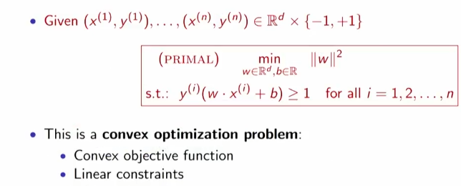

Hard margin SVM

Slide 26
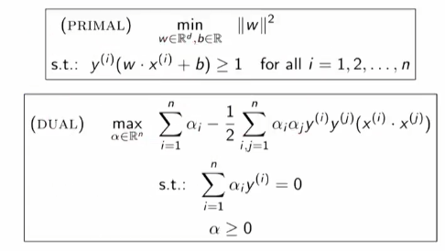
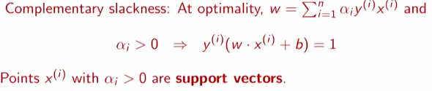
Hard margin dual problem

Slide 27
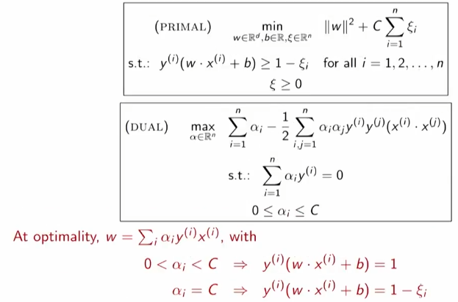
Dual of soft-margin SVM

